Slide 1
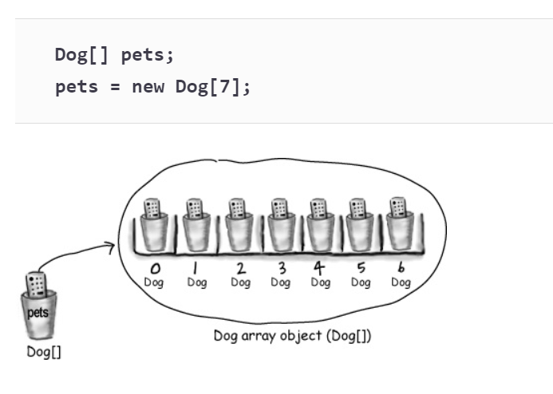
M01 L06 Array of Objects and Design, Implement, Test Classes

Slide 2

Today
Check In
Goals
https://www.youtube.com/watch?v=q52D19UXACY

Slide 3
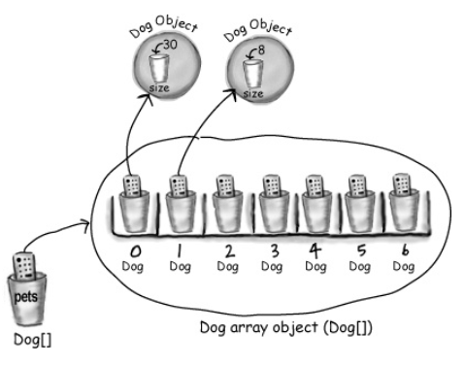
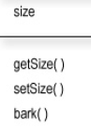
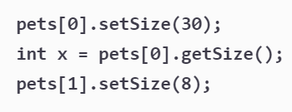
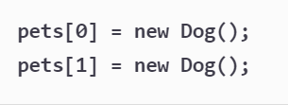
Array of Objects
It can be difficult to keep track of all the objects by making a variable for each one. Instead an array containing the same object can be created.
What is being created?
What is the data type?
What is this doing?
What do you think is actually stored in memory at each array index?
Explain what this code is doing?

Slide 4
Memory
pets is a reference variable holding address to the array on the heap
At each pets index is a reference variable holding address to the dog object on the heap

Slide 5
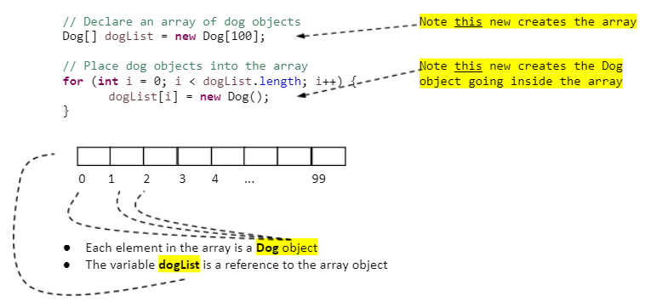
Creating an Array of Objects
An array of primitives is an array of primitive values, like integers, or doules, etc.
An array of objects is an array of reference values holding the address of where object is located on the heap
Processing arrays that hold object types
Each element is set to null as a default value when array is created.
Code in for loop constructs an object. Each element in array holds a reference to a Dog object NOT an actual Dog object

Slide 6
Creating an Array of Objects
An array of primitives is an array of primitive values, like integers, or doules, etc.
An array of objects is an array of reference values holding the address of where object is located on the heap
Processing arrays that hold object types
Each element is set to null as a default value when array is created.
Code in for loop constructs an object. Each element in array holds a reference to a Dog object NOT an actual Dog object

Slide 7

Array of Rectangles Lab
Import TestArrayRectangle.java
Team Collaboration:
Find and fix problem in rectangle class
Construct a third rectangle
Declare an array called rectangles to store 3 rectangles
Assign rectangle1 to index 0, rectangle2 to index 1 and rectangle 3 to index 2.
set the length of the last rectangle using the index
Display the area of the first rectangle using the index
Add code to the printRectangleInformation method
Create a method to return the index of the rectangle with largest length and assume there is only one
Create a method to return the sum of the perimeters for all rectangles in the array
Complete as much as you can before next class.

Slide 8
GE M01 Lab
CS2050 Agile Software Development_.pptx -
Review Software Development Life Cycle,
Designing the Library Class and implement
Test Driven Development
Designing Algorithms when more complex
Code Guidelines to follow for this Class
GE M01
Do not worry about getting everything to work in your code. I am just looking that you implemented some of the concepts.
Explorations are for you to try and know if you need any help. I will not be running your code.
You should have a good tech doc and use some of the code from your guided exploration that contains comments
Feel free to work with others to discuss but you all need to do your own code and documentation

